Slide 1
Capstone Project Report Amazon Product Review Analysis
Prime Pantry Data
Under Guidance Of
Dr. Amit Kumar
Presented By :
Sania Inamdar Subhranil Mondal Tejaswini Dhangar Yash Singh

Slide 2
Problem Statement Data Source
Amazon Prime Pantry data consist of information of Prime members and non-Prime members in selected areas to buy non perishable food items and household supplies in everyday package sizes.
The data we have to download was 5-core and metadata from the Base dataset (https://jmcauley.ucsd.edu/data/amazon/). These two file contains reviews and rating related columns.
After that we are merging the two dataset to get our final dataset to work on.
Customer Retention and Sentiment Forecasting
Customer retention strategy through feedback analysis (Customer classification & clustering as an outcome of analyzing the review text).Trend & seasonality analysis to predict how frequently a particular category of customer would shop in the future.

Slide 3
Description of the treatment on the data
1
2
3
4
Dropping Non-Required Column
Checking Null Values
Data Cleaning
Filling Null Values
Price column is most important column, but we can see that in price column null values are present & it is in string format. So we cleaned the price column,filling the null values & convert the datatype into float.
Correcting the date column & change the date format from 06 13, 2015 to 2015-06-13.
We are merging the review & summary column as review_text because review and summary contents are similar.
Preprocessing Analysis

Slide 4
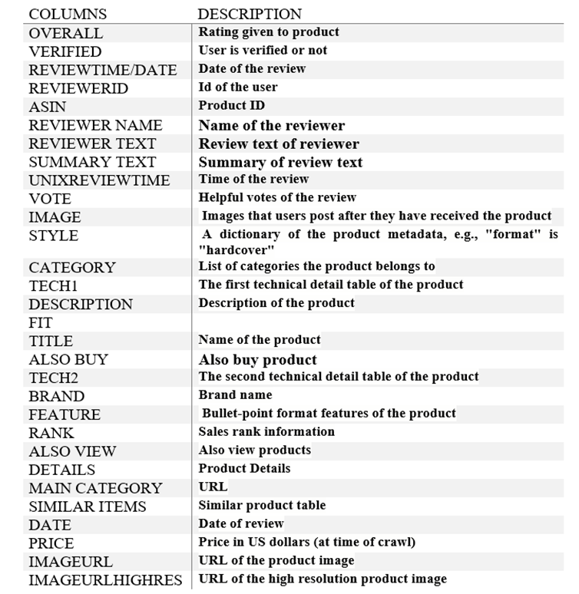
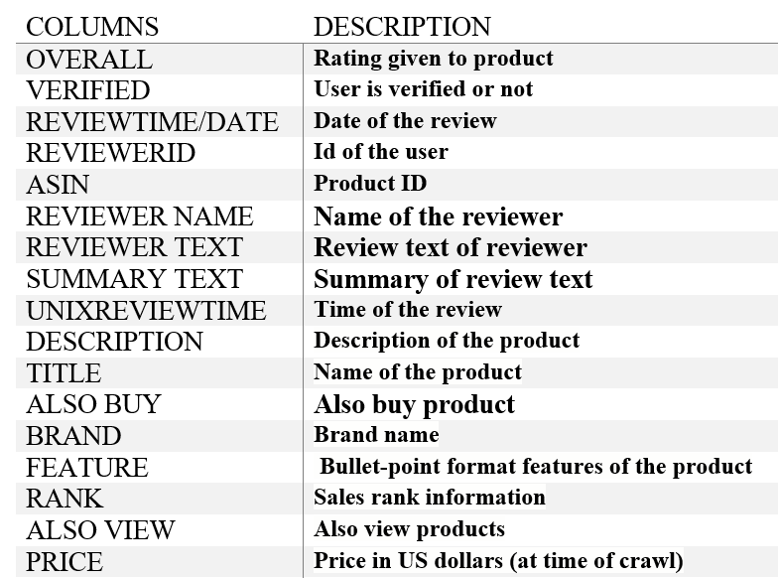
Description of the Dataset
After merging the 5 Core & Metadata on ‘asin’
After Preprocessing size of dataset (137769, 17)

Slide 5
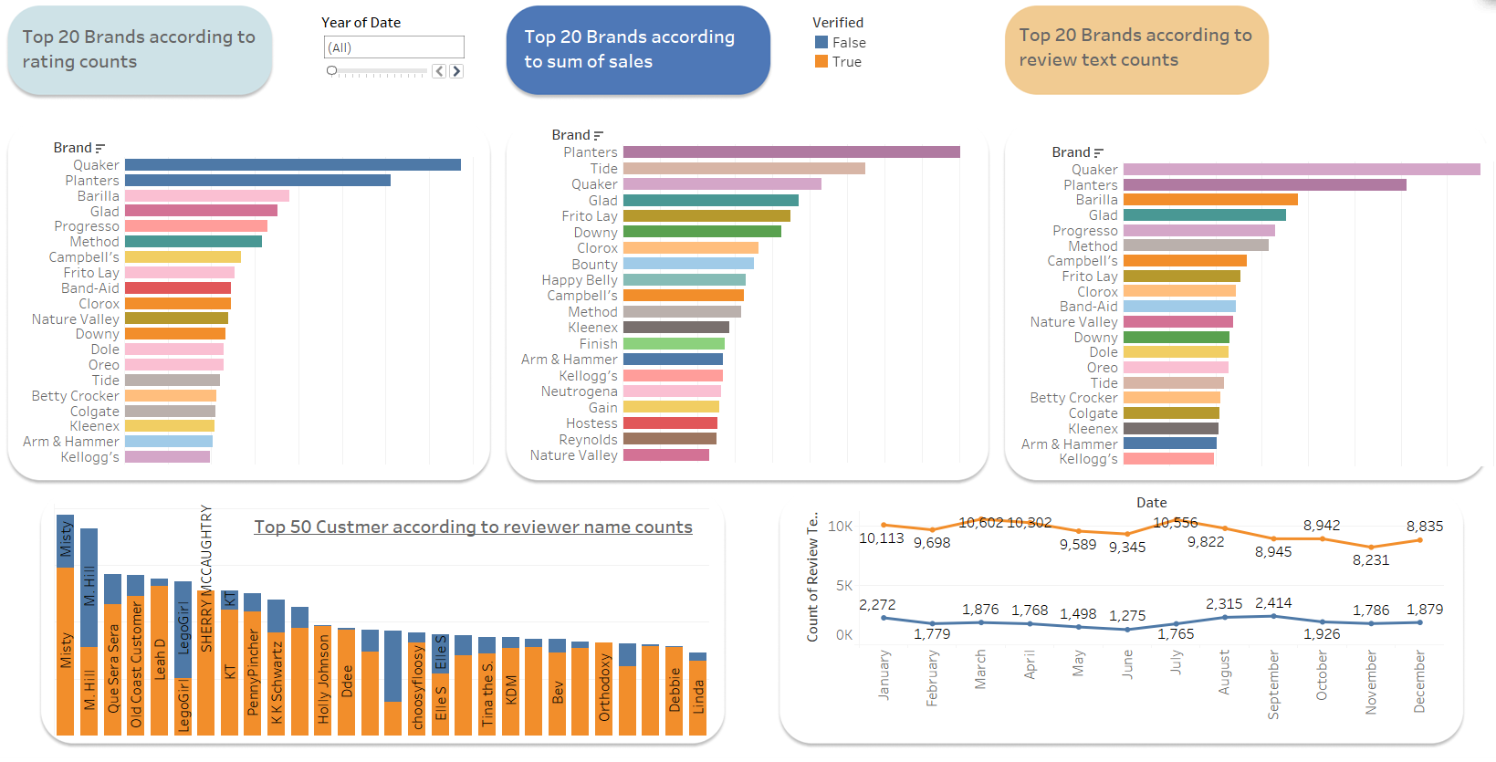
Exploratory Data Analysis

Slide 6
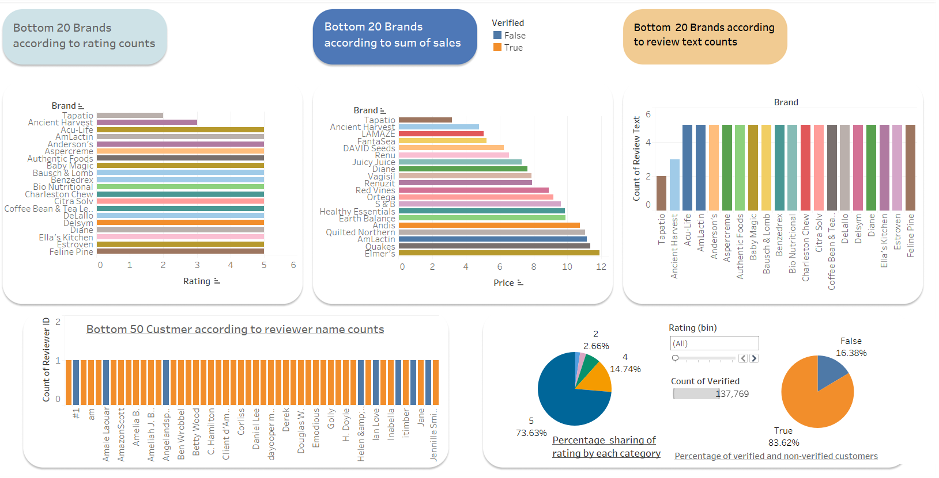
Exploratory Data Analysis (Contd.)

Slide 7
Text Preprocessing & Sentiment Analysis
Text Cleaning
Text Processing
Sentiment
We are removing non-word characters, white spaces, digits, punctuations, stop words from the review_text column.
Then we are going for the lemmatization to reduce the variability in the words. And we are converting the lists into strings and storing the preprocessed data into clean_text column.
We are using TextBlob to calculate polarity of each reviews. And based on polarity we are calculating the sentiments of the reviews. And saved the data in csv format for further use.
Text Blob is a Python library for processing textual data. It provides a simple API for diving into common natural language processing (NLP) tasks such as part-of-speech tagging, noun phrase extraction, sentiment analysis, classification, translation, and more.
Polarity score lesser than or equal to zero is termed ‘Negative’, Score greater than or equal to 0.5 is termed ‘Positive’, and score ranging between 0 to 0.5 is termed ‘Neutral’.

Slide 8
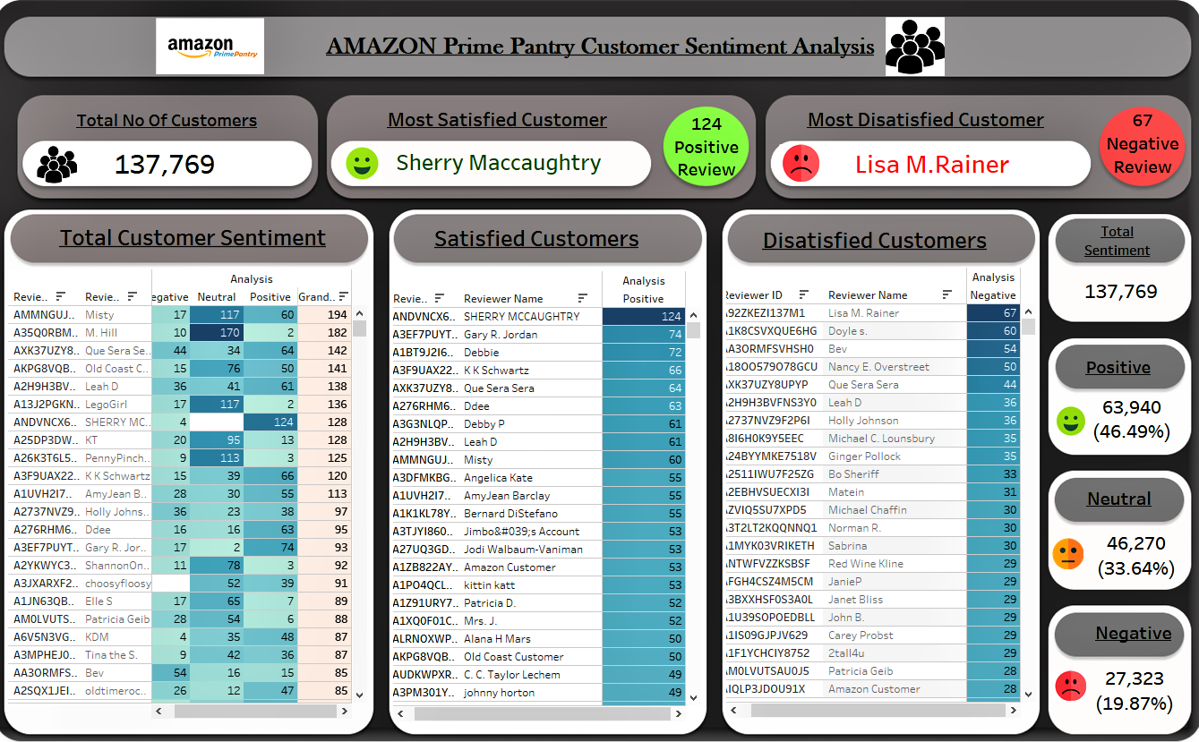
EDA on Sentiment Analysis

Slide 9
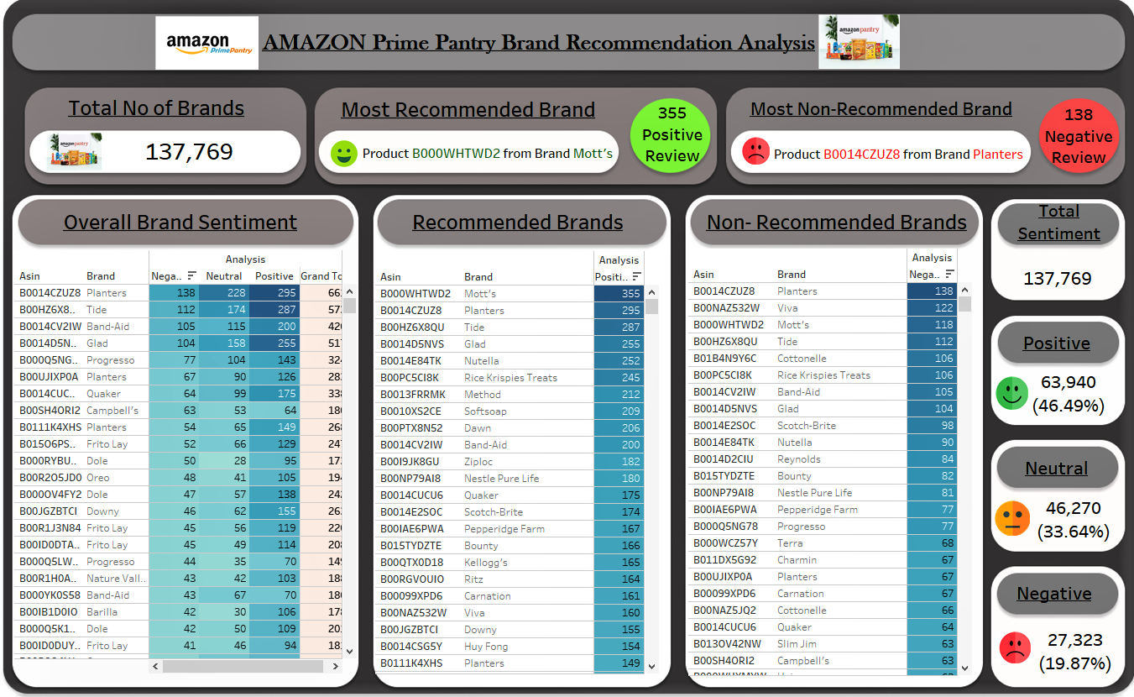
EDA on Sentiment Analysis (Contd.)

Slide 10
Classification Analysis
Objective: To build best supervised ML model to predict the sentiments of unseen reviews.
Classification Analysis
1
2
3
4
5
6
Gathering Data
Splitting Data
Vectorization
Model Building & Evaluation
Hyper Parameter Tuning
Prediction
Defining target column & Feature column.
Splitting the data into train test split at 70:30 ratio
Converting text data into numeric by vectorization methods.
Build 4 model to obtain the best evaluated model for the data
Hyper Parameter Tuning of best model to improve the model performance.
Predicting the unseen data by best model to observe the performance.

Slide 11
Classification Models
Models used for Classification
1
Logistic Regression
Logistic regression is a statistical method for predicting binary classes.
It computes the probability of an event occurrence.
2
Multinomial Naive Bayes algorithm is a probabilistic learning method that is mostly used in NLP.
The algorithm is based on the Bayes theorem and predicts the tag of a text
Multinomial Naive Bayes
3
Decision Tree Classifier
A decision tree is a flowchart-like tree structure where an internal node represents feature, the branch represents a decision rule, and each leaf node represents the outcome.
4
KNN Classifier
KNN is a non-parametric learning algorithm. Non-parametric means there is no assumption for underlying data distribution.

Slide 12
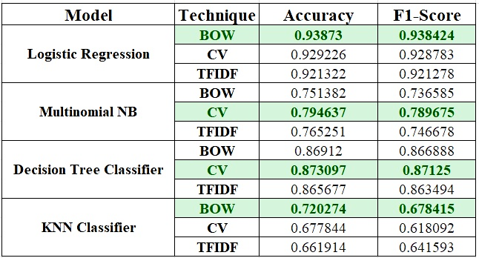
Model Summary
Vectorization Techniques Used:
Bag Of Words: Bag of words counts the occurrence of each words but doesn’t preserve the order of the sentence.
Count-Vectoriser: It is used to transform a given text into a vector on the basis of the frequency (count) of each word that occurs in the entire text. But it will consider the order of the words.
TF-IDF: Term Frequency Inverse Document Frequency of records. It can be defined as the calculation of how relevant a word in a series or corpus is to a text. The meaning increases proportionally to the number of times in the text a word appears but is compensated by the word frequency in the corpus (data-set).
We can observe that in Logistic Regression by Bag Of Word method we are getting highest Accuracy & F1 score.

Slide 13
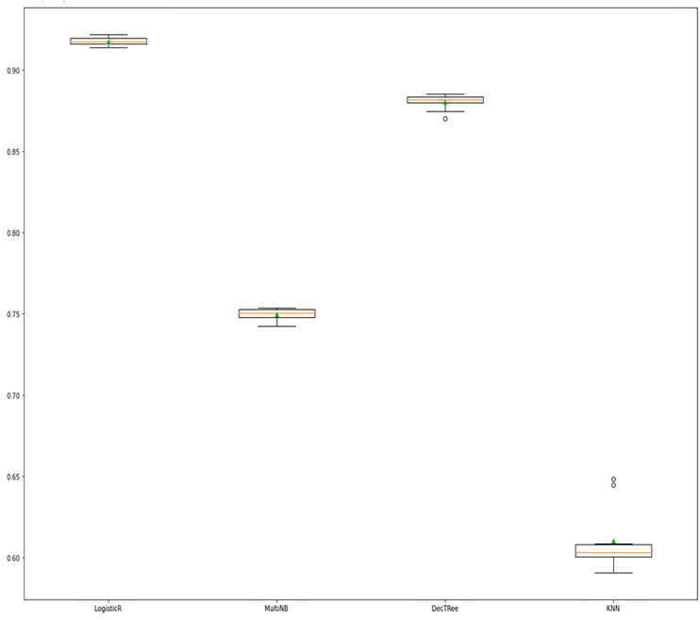
Tf-Idf Vectorization method with Cross Validation
Cross-validation is a technique in which we train our model using the subset of the data-set and then evaluate using the complementary subset of the data-set.
From the visuals we can say that the Logistic Regression model gets the higher F1 score (91.8%) among all the models.

Slide 14
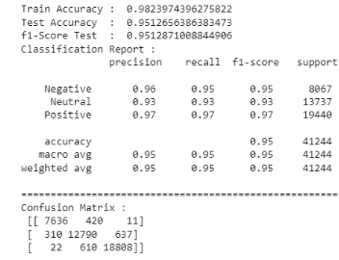
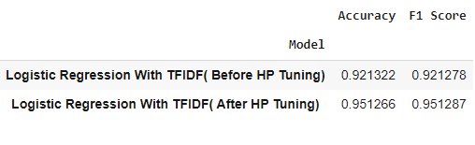
Hyperparameter Tuning
According to model evaluation Logistic Regression gives us better accuracy & F1 score compared to others.
Considering L1,L2 penalties and logarithmically spaced C values.
We are applying Grid search cv on this.

Slide 15
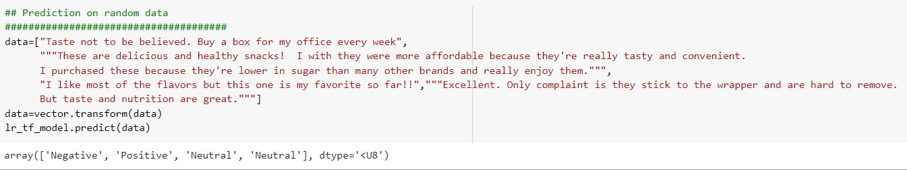
Prediction on Random Data
After hyper parameter tuning as our model getting 95% accuracy. So here we are testing our model on random data.
Predicting the random data on best model:

Slide 16
Clustering Analysis
To construct groups or clusters while ensuring that the observations are as similar as possible with sentiments.
Clustering Analysis
1
2
3
4
Feature Extraction
Cluster Selection
Model Building
Model Evaluation
Selecting the columns for cluster formation
Selecting the number of clusters by Elbow curve, K distance graph, Dendrogram
Building 3 Models to obtain the best clusters
Evaluating best model by cluster formation on Scatter plot

Slide 17
Clustering Algorithms
.
1
K-Means
It classifies the dataset by dividing the samples into different clusters of equal variances.
2
Agglomerative Hierarchical
The Agglomerative hierarchical algorithm performs the bottom-up hierarchical clustering.
3
The areas of high density are separated by the areas of low density.
DBSCAN

Slide 18
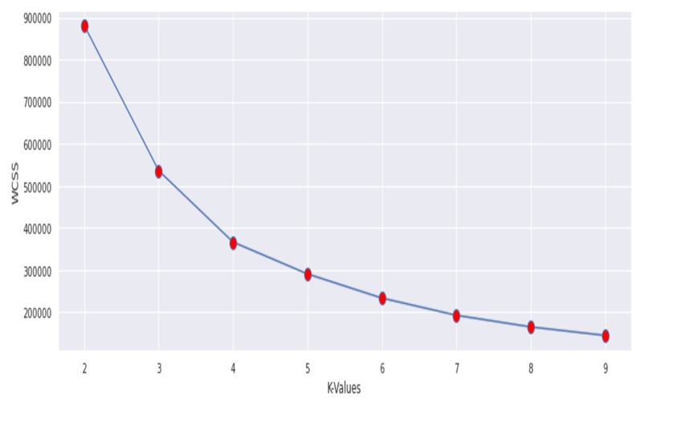
K Means Clustering
Feature Selection:
Rating
Price
Polarity
Elbow method: To find the optimal value for k

Slide 19
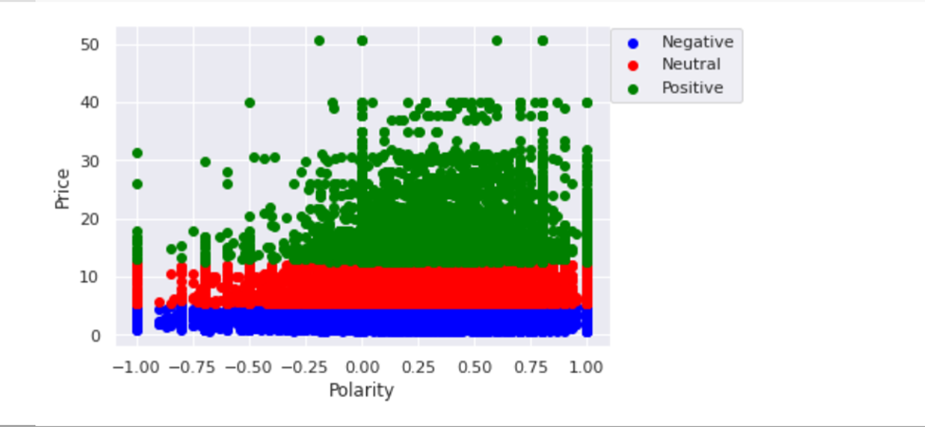
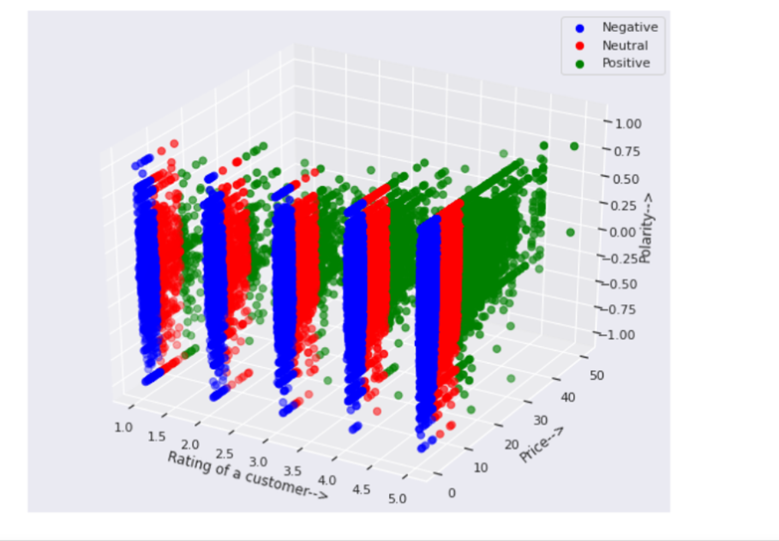
Clustering Evaluation
Getting Optimum Clusters By K-Means
From 2D plotting we can’t interpret properly.
By 3D plotting now we can Interpret the clusters properly.

Slide 20
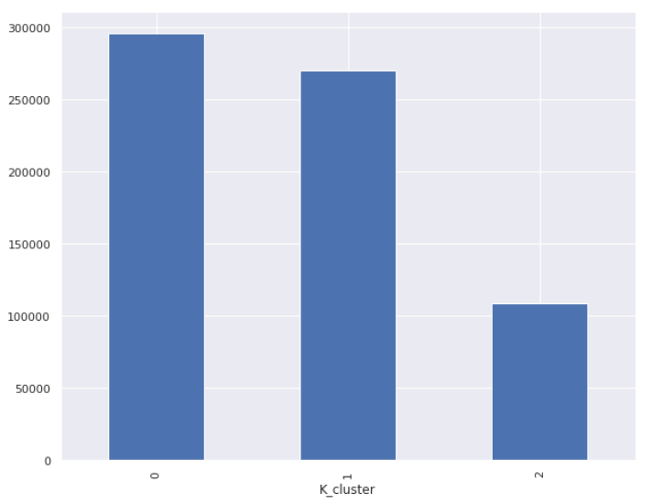
Result of Clustering
The clusters 0 represents products with positive review and having maximum sales.
The cluster 1 represents products with neutral reviews.
Cluster 2 represents products with negative reviews having lesser sales compare to other two clusters.
So, we need to focus on products belonging to cluster 2 such as Tapatio, Ancient Harvest. So we can increase the quality of those products.
Cluster ‘0’=’Positive’
Cluster ‘1’=’Neutral’
Cluster ‘2’=’Negative’

Slide 21
Time Series Analysis
Objectives: Through Time Series Analysis we are going to predict/forecast the future sentiment of the customers shopping on Amazon Prime Pantry.
1
2
3
4
5
6
Splitting Sentiment
Resampling
Decomposition
Check Stationarity
Time Series Model
Sentiment Forecasting
Split overall sentiments into 3 different column Positive,Neutral,Negative
Resampling the data Quarterly to get the continuity in the data
To visualize time series components
Checking the stationarity of the data by ADF test
ARIMA, SARIMA models on Positive, Neutral, Negative Sentiments
On the best model we will forecast the upcoming sentiments
Time Series Analysis

Slide 22
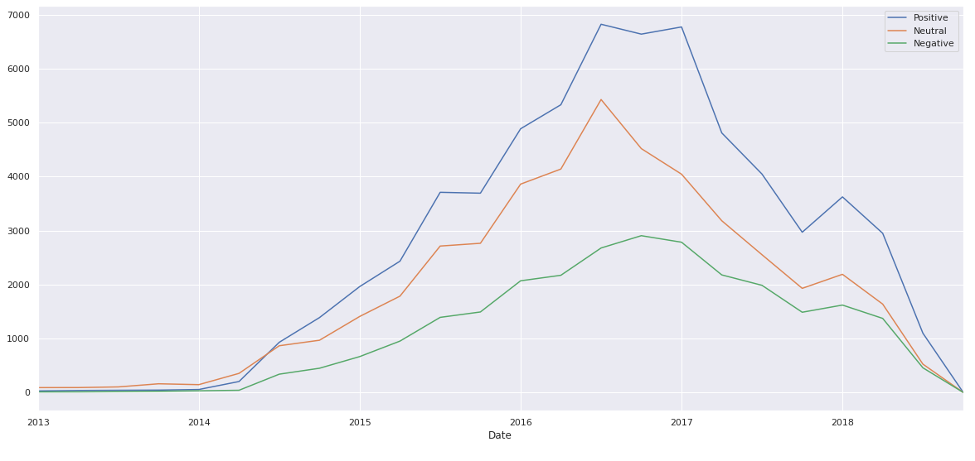
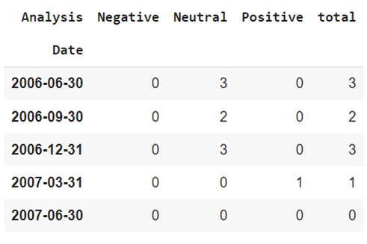
Time Series Analysis(Contd.)
Data Understanding :
Split overall sentiments into 3 different column Positive,Neutral,Negative.
Plot of Sentiments:

Slide 23
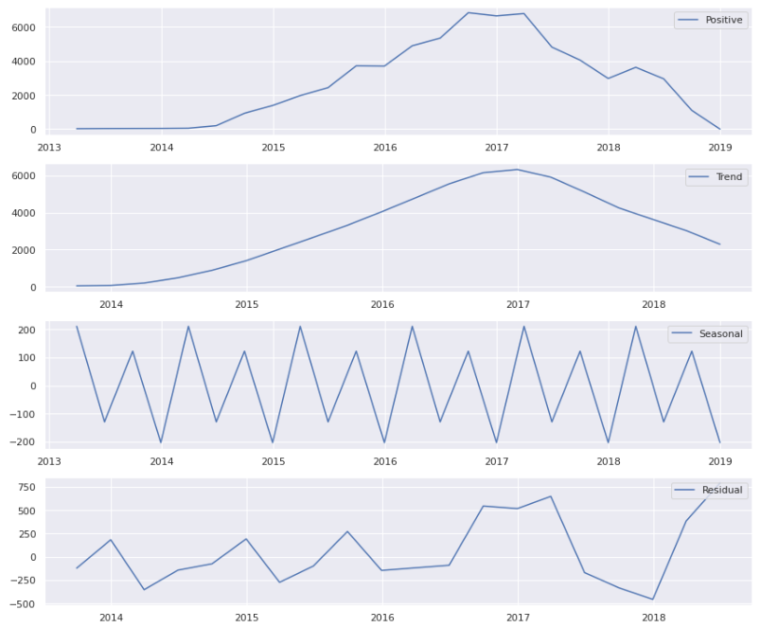
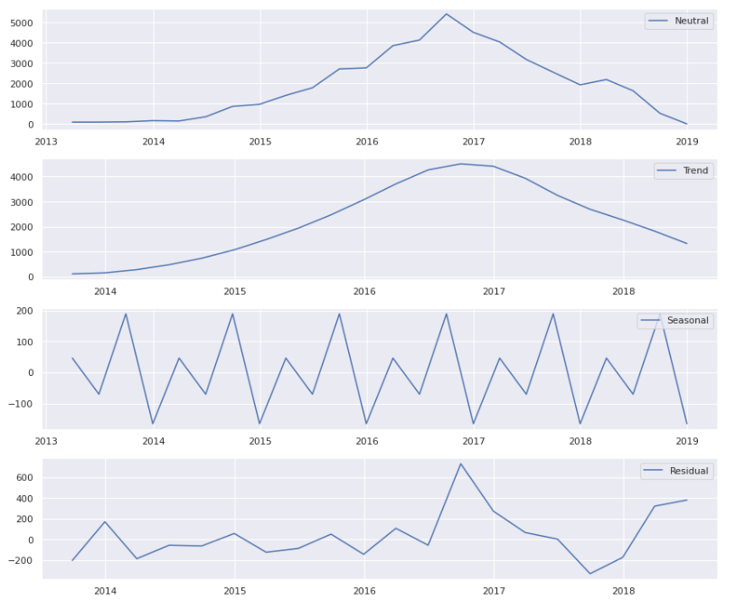
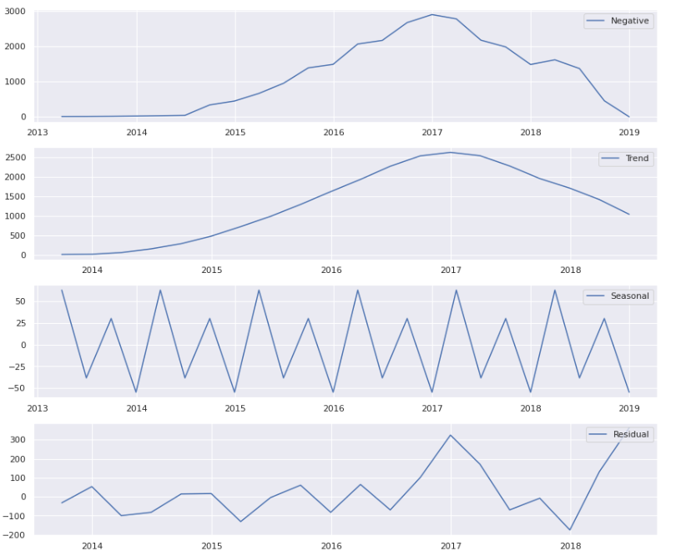
Decomposition Plots
Positive Sentiments | Neutral Sentiments | Negative Sentiments

Slide 24
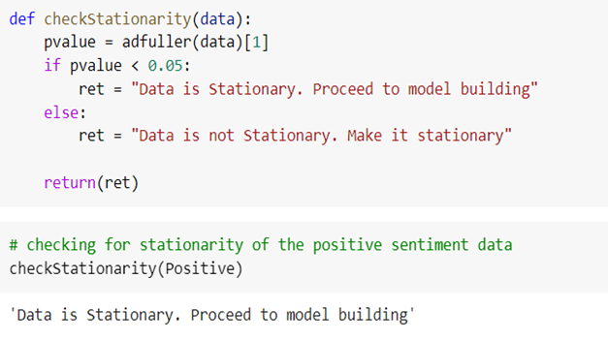
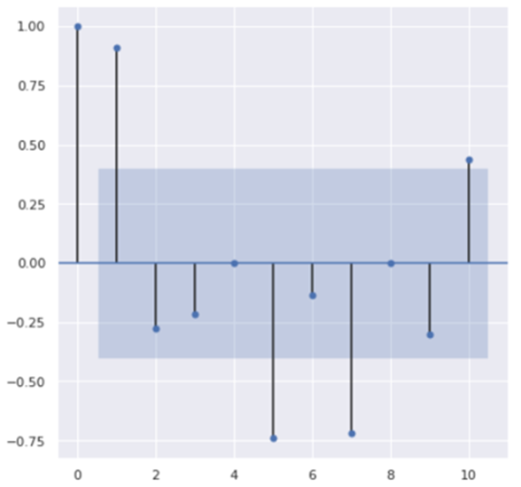
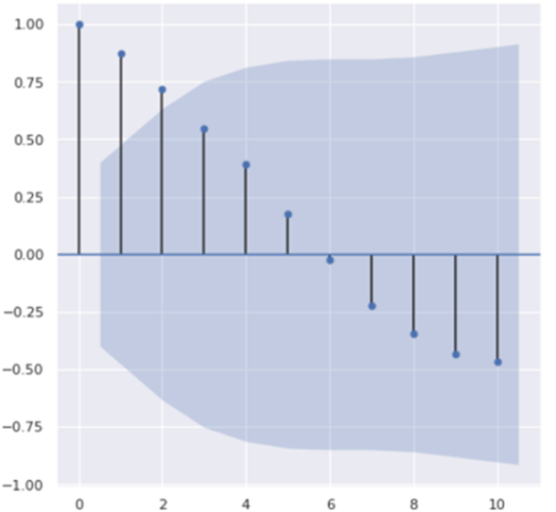
Time Series Analysis(Contd.)
Stationarity Check
We have done stationarity check through Augmented Dickey Fuller test.
ACF
Autocorrelation function (ACF) is a measurement of how related the actual value is to the previous values including trend and seasonality.
PACF PLOT (p) ACF PLOT(q)
PACF
Partial Autocorrelation function (PACF), unlike the ACF, finds the correlation between the residual values in the series,therefore it is only the partial function.

Slide 25
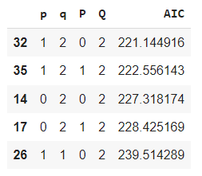
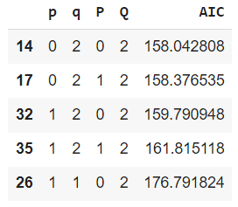
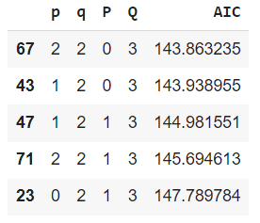
Time Series Models
ARIMA is a [p,d,q] model, p takes values upto previous p periods, q takes residuals upto q lags and d degree of difference done on data.
SARIMA or Seasonal ARIMA, is an extension of ARIMA that explicitly supports univariate time series data with a seasonal component. All things remain same as ARIMA model but new seasonality elements are added.
Selecting p,q,P and Q values for positive sentiment based on low AIC Score. | Selecting p,q,P and Q values for neutral sentiment based on low AIC Score. | Selecting p,q,P and Q values for negative sentiment based on low AIC Score.

Slide 26
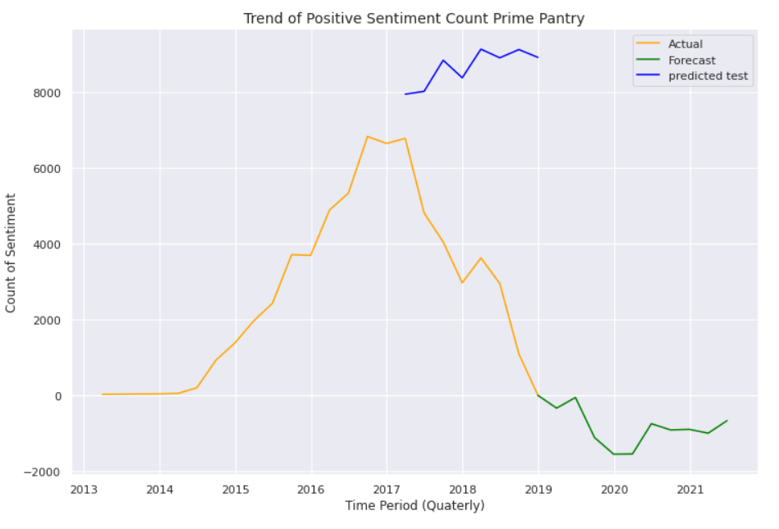
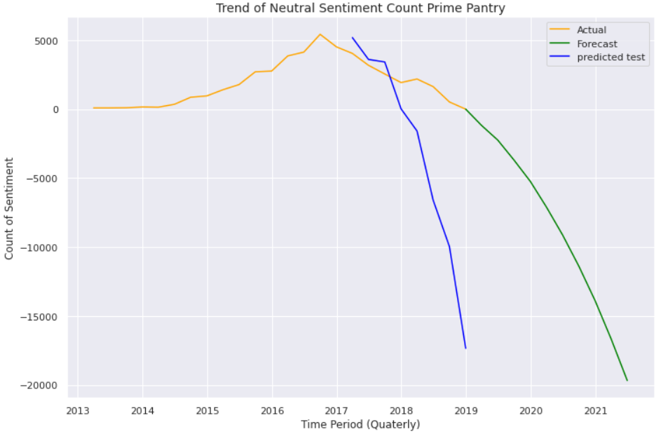
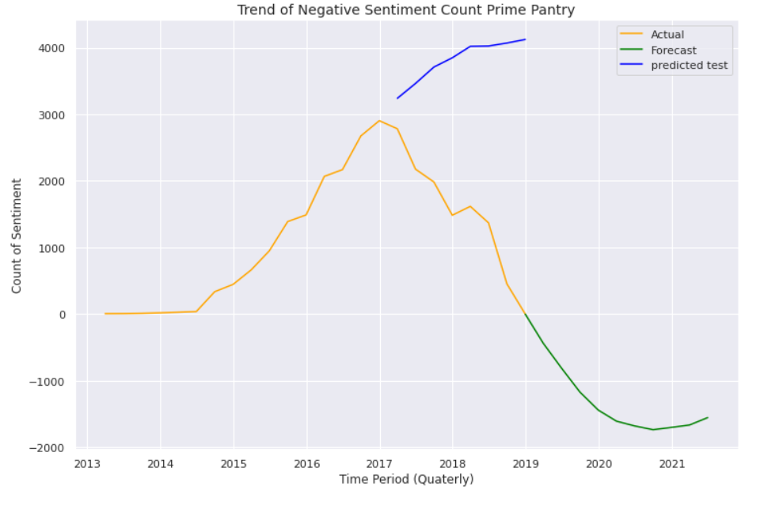
Sentiments Forecasting
Positive Sentiment Forecasting | Neutral Sentiment Forecasting | Negative Sentiment Forecasting
From the plot we can say that the positive sentiments of customers will decrease till 2020 and after that it will increase, as per shopping habits of people.
From the plot we can say that the neutral sentiments of customers will gradually decrease ,as per shopping habits of people.
From the plot we can say that the negative sentiments of customers will decrease till 2020 and after that it will slightly increase, as per shopping habits of people.

Slide 27
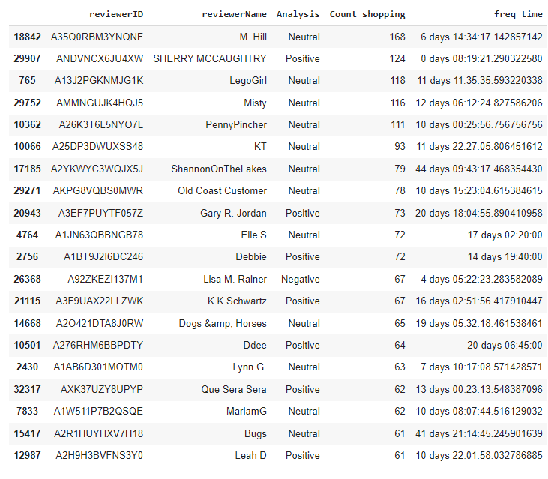
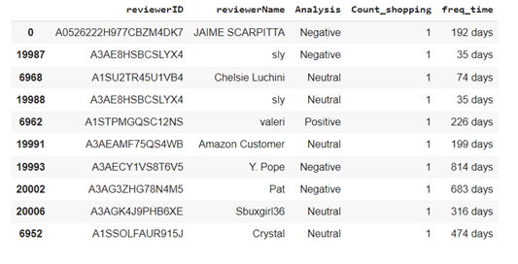
Conclusion
Customer we should focus on
Customer would likely to Churn out

Slide 28
Conclusion(Contd.)

Slide 29
Business Insights
We will recommend our classification model to predict the sentiments of the reviews related to prime pantry products.
We will recommend our clustering model to identify in which cluster the new customers will fall based on their shopping habits.
The positive sentiments of customers will decrease till 2020 and after that it will increase. So we can suggest the products from various brands that got moderate to low rating, try to improve the quality of the products so that the positive reviews remain constant or increase gradually.
The neutral sentiments of customers will gradually decrease. So we may say that the neutral reviews will move towards either positive or negative reviews. So we can suggest the products from the brands that got the neutral reviews more, upgrade the quality or sales so that it will move towards positive reviews more.
The negative sentiments of customers will decrease till 2020 and after that it will slightly increase. So we will recommend to increase the advertisements, simultaneously improve the quality of product and sales so that more people will buy those products & give more number of reviews.

Slide 30
Thank You

